Slide 1
Racing Related games
By Thomas Simmons
S176601

Slide 2
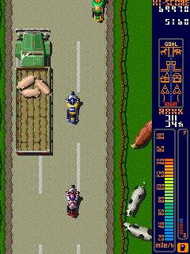
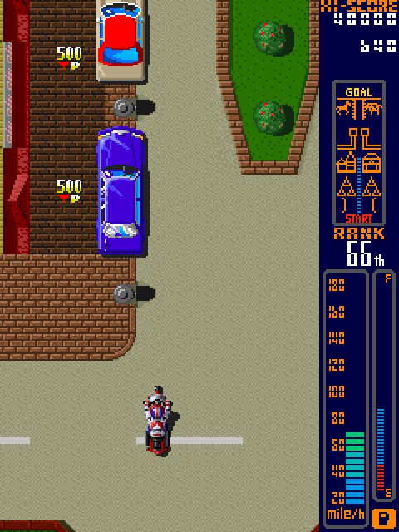
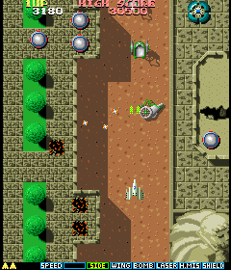
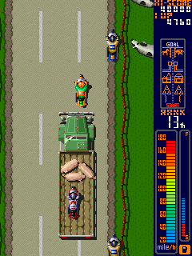
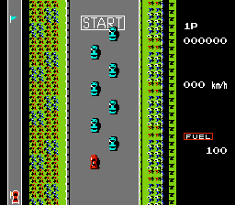
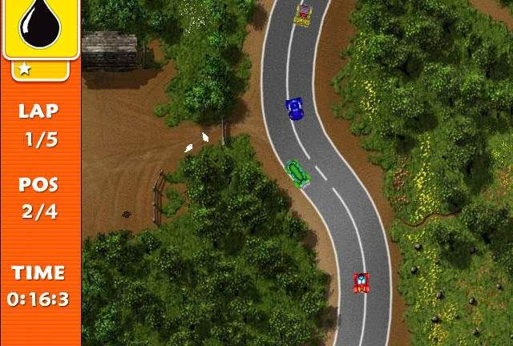

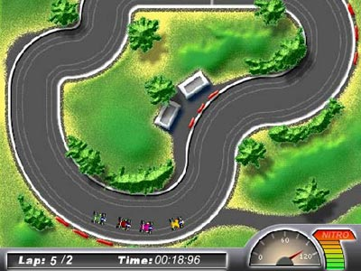

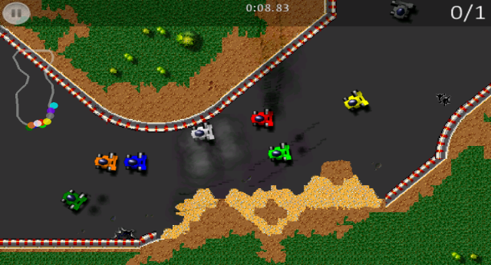
Birds Eye View Racing Games
These games are mostly 2d pixelated games. They include:
Endless runner high score wins
Circuit race for up to 8 racers
Oval racing till gas runs out
Race and destroy opponents cars

Slide 3


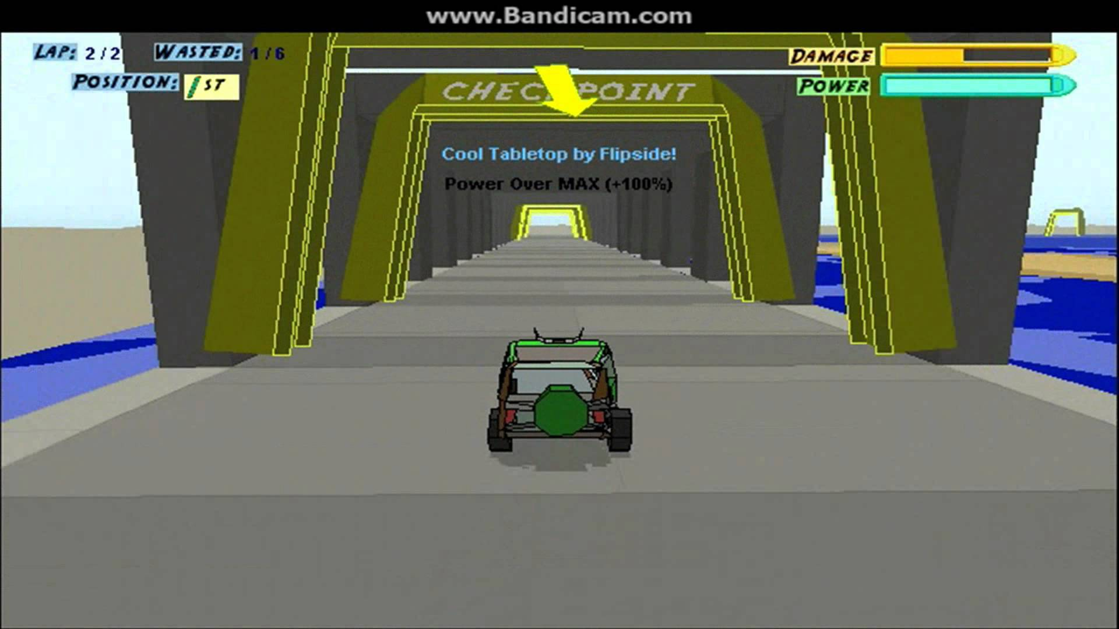
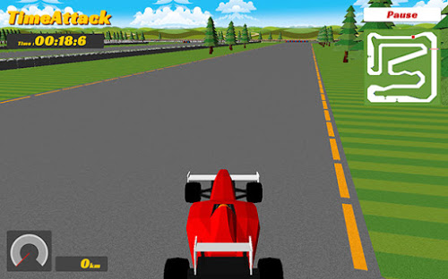
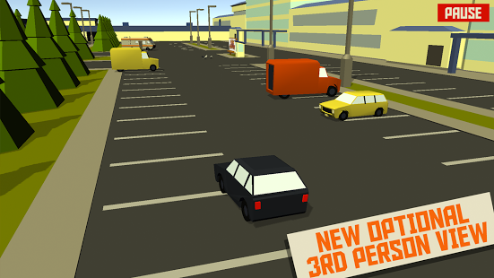
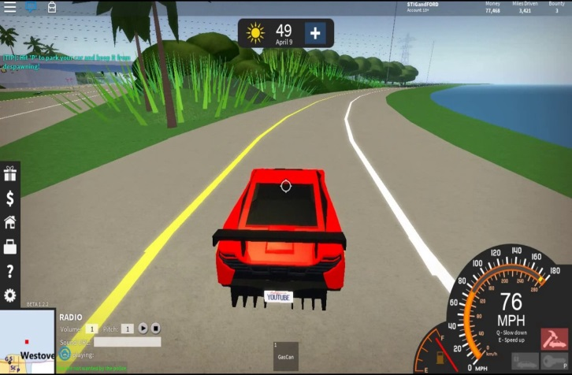
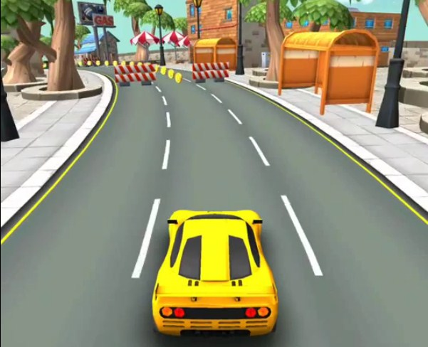
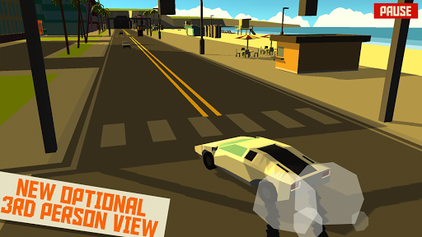
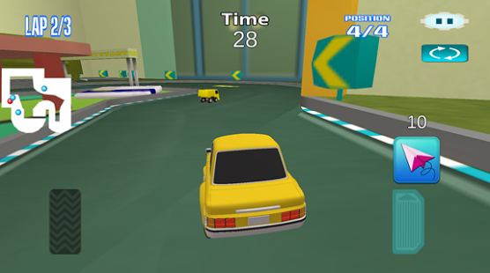
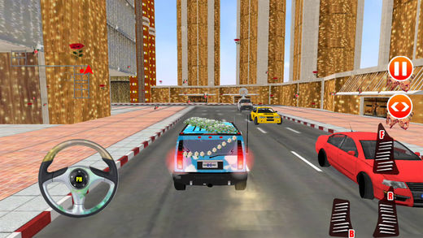
Third Person Racing Games
These games tend o be either:
Endless runner collecting coins
Car parking, driving simulations
Sprint/circuit racing
Some of these games have multiplayer making them very competitive.

Slide 4
Game Demographics 2014
47% of gamers are women in America
29% of gamers are over the age of 50 years old
16% of gamer kids play with parents
40% of gamer kids with friends
17% play with their spouse or carer
89% of parents watch over what there children purchase on games
Average age of players in America is 30 years old and 35 for the UK
36% play games on their smart phone/Tablet
32% of players are 18 years of age or less

Slide 5
Game Demographics 2015
29% of gamers are 18 years old or less
The average age of gamers in America are 31 years old
74% of teachers use game related methods to teach.
48% of gamers in America are female and male is 52%
In the UK female games has risen to 52%.
Mobile games made 30.3 billion dollars
Ages 35-44 spent the most on games ($6 per person per month)
YouTube gaming channels make 3.5 billion
71 million people watch competitive gaming

Slide 6
Recommended Target Audience
Male and Female gamers aged between 25-35 who play on their phones/tablets.
This is due to:
The average gamer age in the US and UK
Male and Female gamers ratio is even
Mobile apps are more profitable

